Slide 1
Essential Process Modeling
Name: Deepanjan Ran

Slide 2
Contents:
Introduction
First Steps with BPMN
Branching and Merging
Exclusive Decisions
Parallel Execution
Inclusive Decisions
Rework and Repetition
Business Objects
Resources
Process Decomposition
Process Model Reuse

Slide 3
Introduction
Process modeling is an activity to know the process before hand or the process blueprint way before implementation.
Process modeling helps understand how the flow should be and how all the components and elements should fall in the right place.
Process modeling is understanding the process and sharing the understanding with people involved in the process.
This also helps in identifying risks and errors with the process beforehand.
In the same way it also helps in analyzing the business model to make changes to the same for better performance.

Slide 4
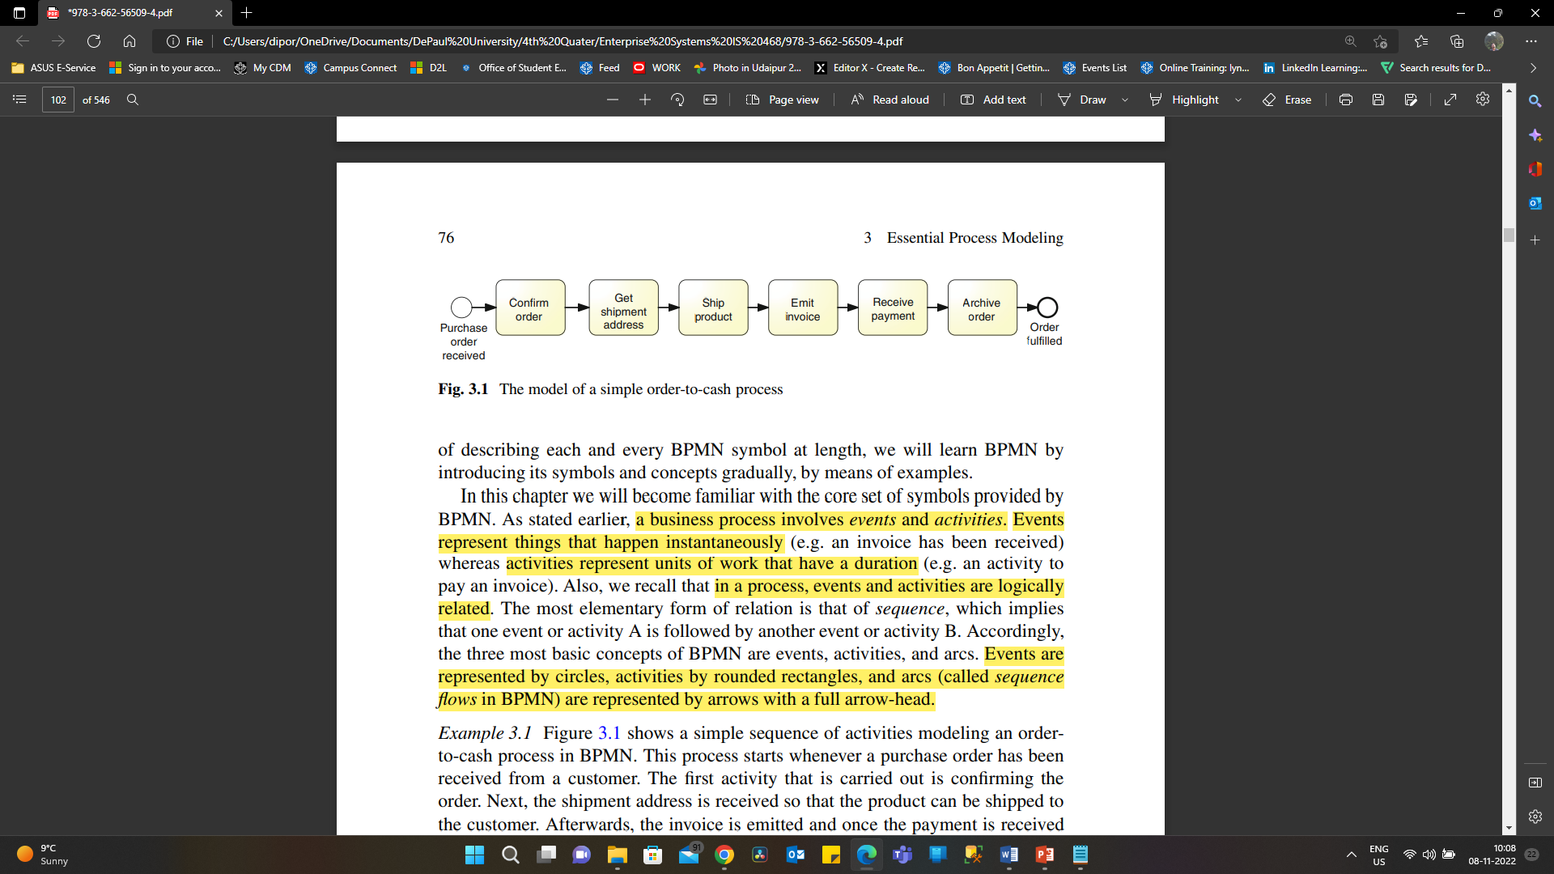
First Steps with BPMN
BPMN is nothing but a Business Process Model and Notation, which deals with a graphical representation of a business model with notations for better understanding.
Basic concepts of BPMN are element, activity, and arc.

Slide 5
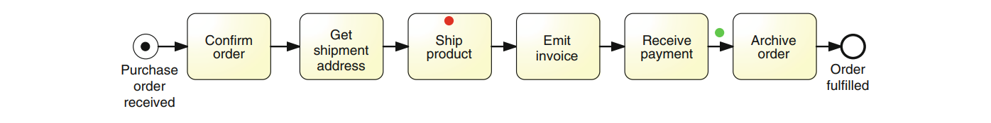
First Steps with BPMN
Use of token, to identify the state of the process.
They are indicated with dots that can be of different colors.
Created at the start of the event and are carried throughout the process until they are destroyed
at the end.

Slide 6
First Steps with BPMN
Standard naming conventions:
It is always better to label the activities and events.
As thumb rule avoid labels with more then 5 words.
For activities, the label should begin with a verb in the imperative form followed by a noun referring to a business object, e.g. “Approve order” also noun can be followed by adjective such as “Issue driver license”
For events, the label should begin with a noun and end with a past participle, e.g. “Invoice emitted”.
The name of the process model should be a noun preceded by an adjective. E.g. “loan origination”.
Process names are usually in lower case.

Slide 7
Branching and Merging
Branching and merging deals with splitting the process in different branches and similarly combining different split branches into one flow.
This is usually done when activities and events are not performed sequentially.
This is applied on concurrent activities. That means the process has 2 or more activities that do not require to be in sequence and can run parallel at same time. E.g. Notification and disbursement activity can run parallel without depending on each other.
The term gateway implies that there is a gating mechanism that either allows or disallows passage of tokens through the gateway.
These token when arrive at a gateway can either merge or split depending on the gateway type.

Slide 8
Branching and Merging
This has four different types
Exclusive Decisions
Parallel Execution
Inclusive Decisions
Rework and Repetition

Slide 9
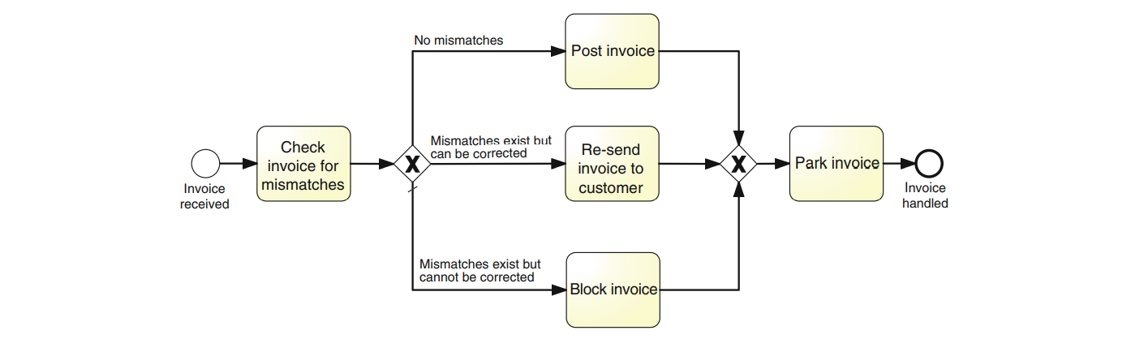
Exclusive Decision
It is also called as XOR.
We use an XOR-join to merge two or more alternative branches that may have previously been forked with an XOR-split.
It is mutually exclusive conditions, i.e. only one of them can be true every time the XOR-split is reached by a token
An XOR gateway is indicated with an empty diamond or with a diamond marked with an “X”.

Slide 10
Parallel Execution
As the name state the activities that are not dependent on each other and can be performed independently or concurrently are called parallel execution.
This gate is denoted with AND.
We use an AND-split to model the parallel execution of two or more branches, and an AND-join to synchronize the execution of two or more parallel branches.
AND gateway is depicted as a diamond with a “+” mark.

Slide 11
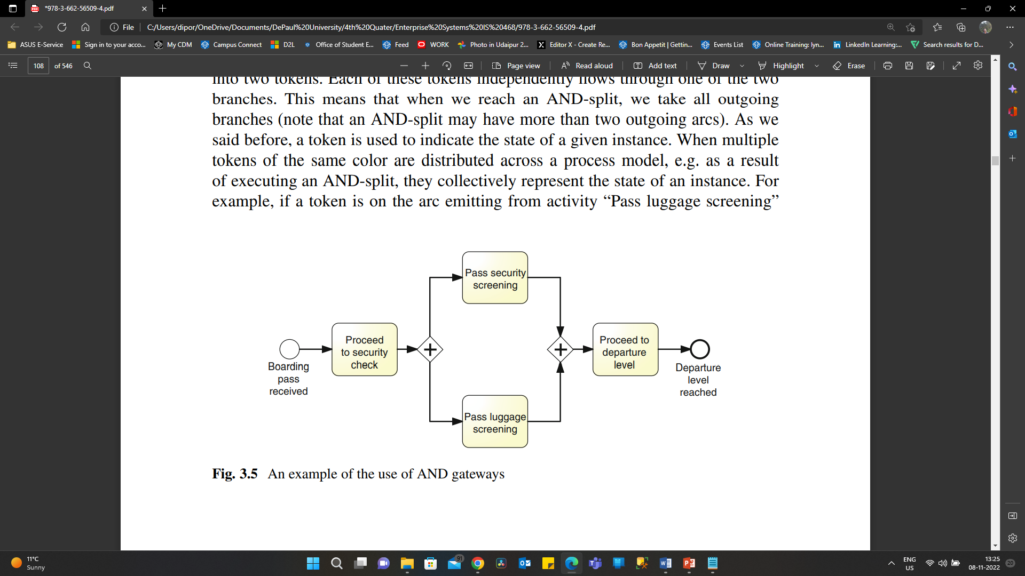
Parallel Execution

Slide 12
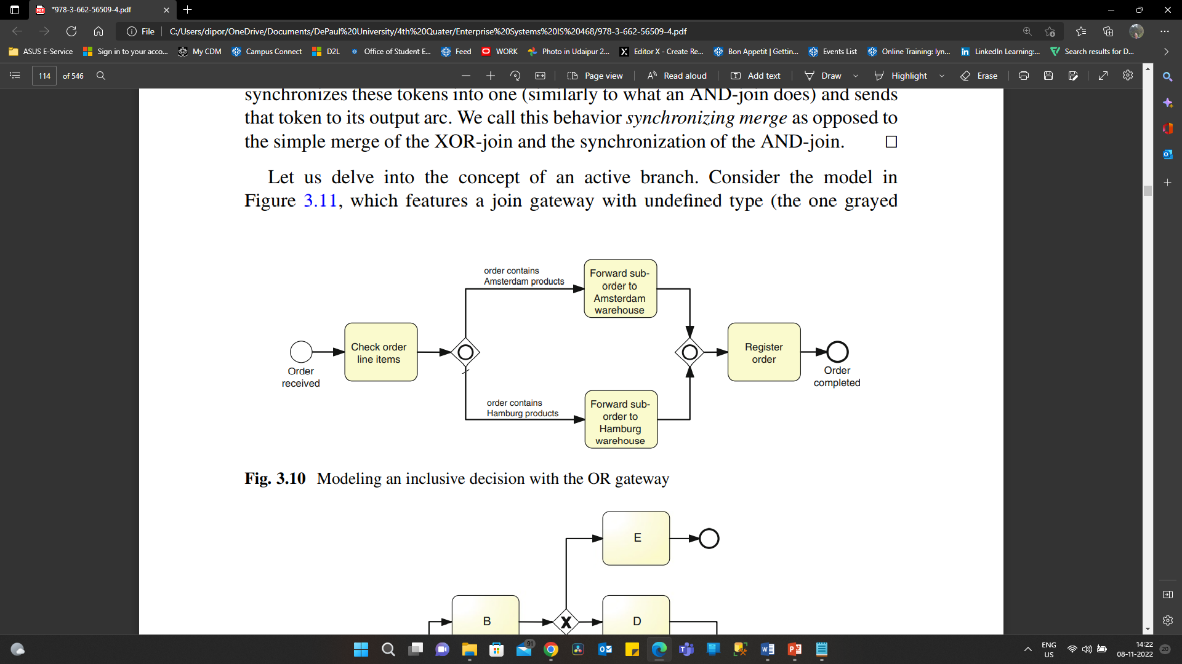
Inclusive Decisions
Model situations where a decision may lead to one or more options being taken at the same time, we need to use an inclusive.
It is denoted with OR gateway.
This split is similar to exclusive decision or XOR gateway but in inclusive decision branches do not need to be mutually exclusive.

Slide 13
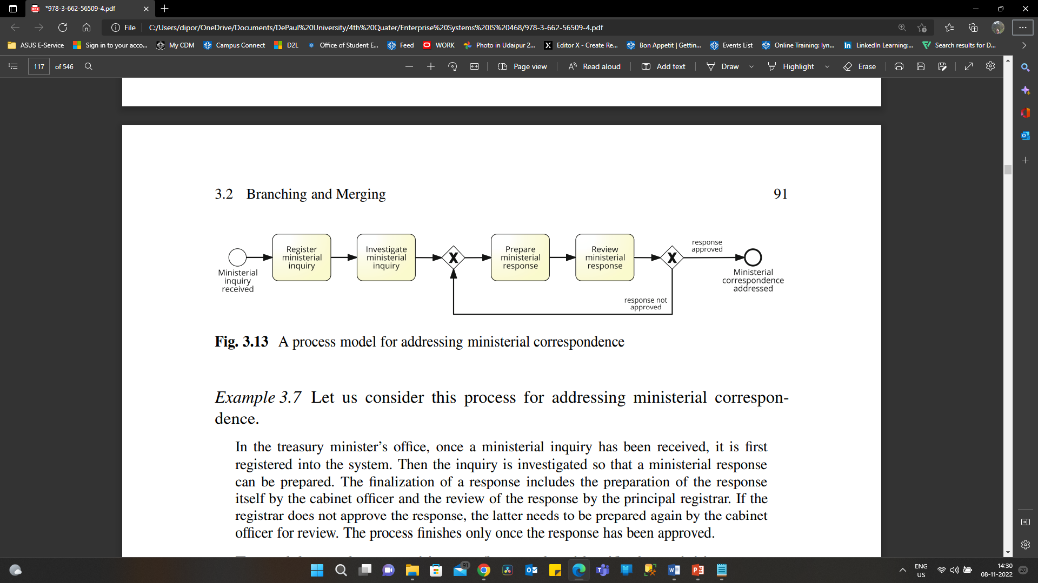
Rework and Repetition
Some activities fail due to various reasons in the flow or the process. E.g. bounced cheque.
In this scenarios we need to redo the process from a particular stage or activity this where Rework and repetition comes in picture.
This is done on the activities that are performed more than once and can be reconsidered or rechecked.

Slide 14
Business Objects
Business objects are also known as artifacts that are required to perform a activity, they are also produced as a out put of that activity.
Business objects are nothing but items or prerequisite that are required to perform an activity. They are mainly of data perspective.
Some business objects are also known as data objects in BPMN.
They can be physical object carrying information and data or electronic objects such as PDFs and emails.

Slide 15
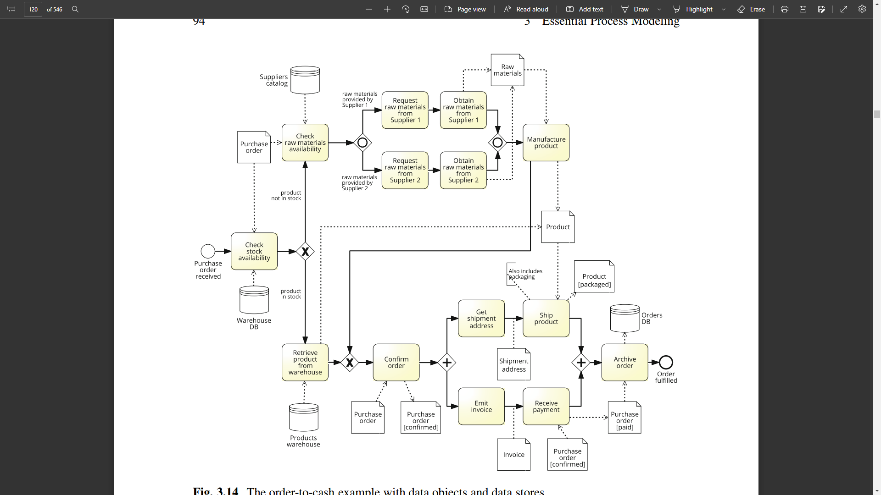
Business Objects

Slide 16
Resources
Resources is one of the aspect to be considered in business process modeling.
Resource perspective is also called as organizational perspective.
It is a generic term to refer anyone or anything involved in the performance of process activity.
A resource can be person, software, machine etc.
There are two types of resources:
Active : that can autonomously perform an activity.
Passive : that are merely involved in the performance of an activity.

Slide 17
Resources
BPMN provides two constructs to model resource aspects:
pools and lanes.
Pools are generally used to model resource classes.
lanes are used to partition a pool into sub-classes or single resources.

Slide 18
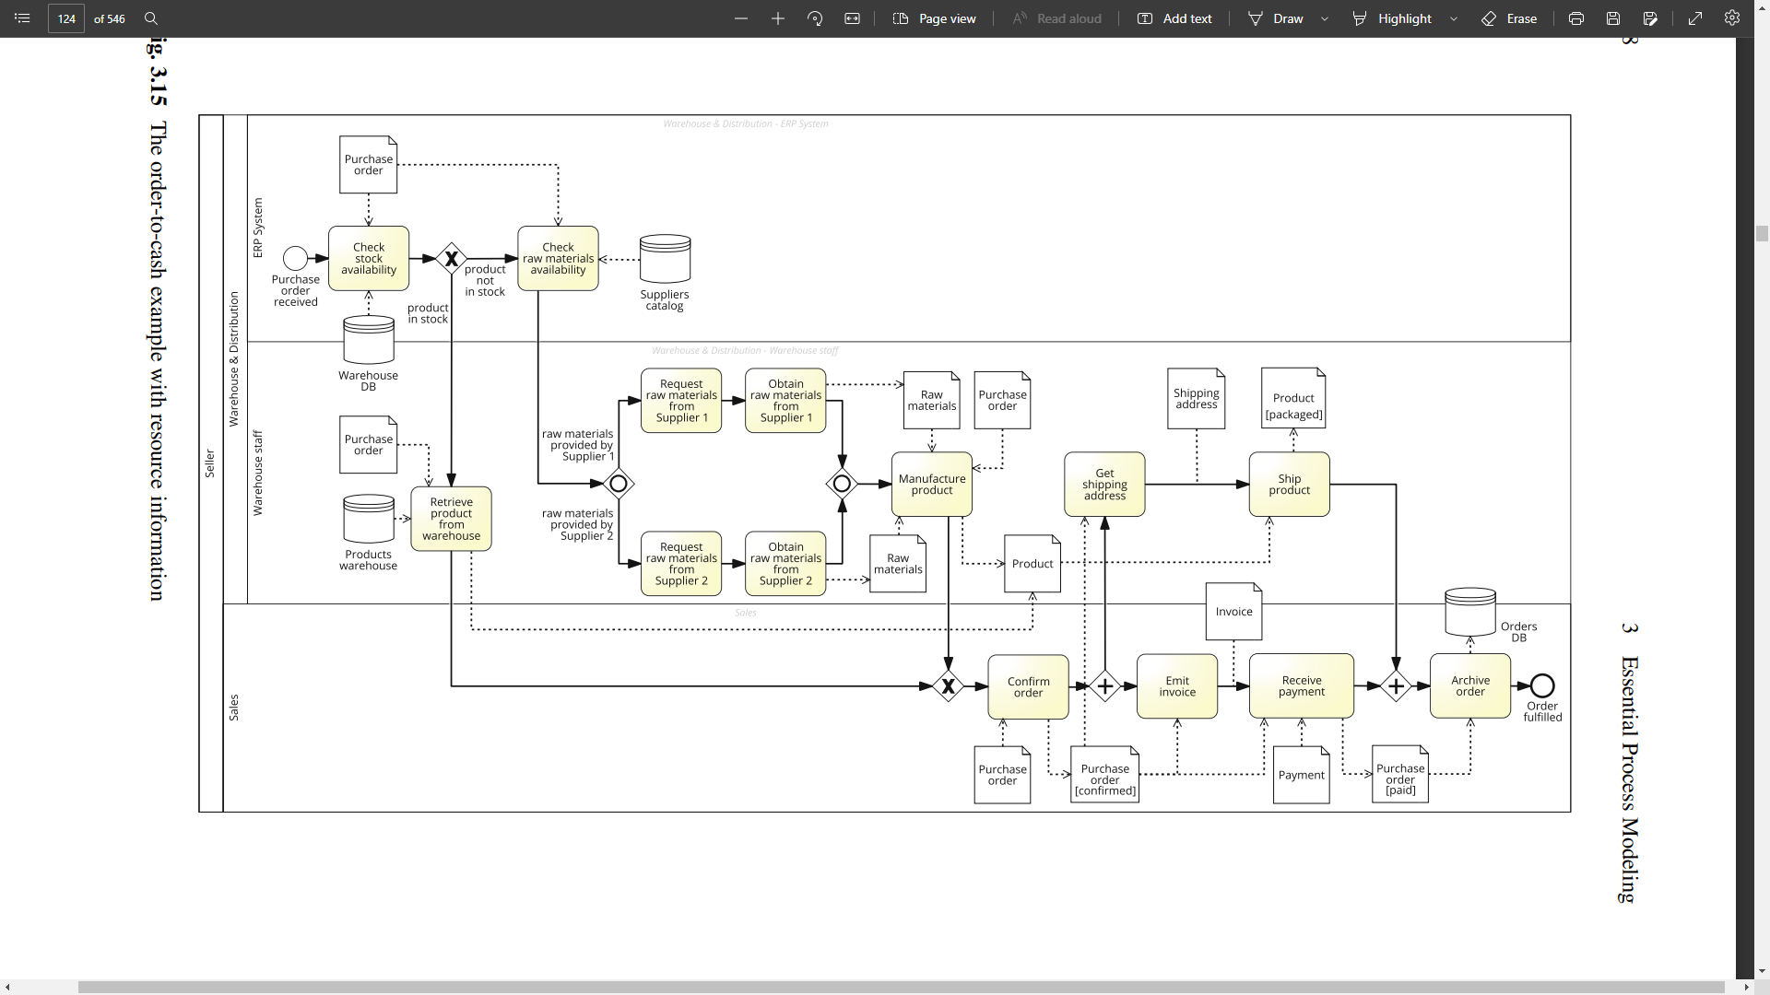

Slide 19
Process Decomposition
While making business model we usually end up constructing large models with many elements that can be confusing with respect to understandability.
For this purpose process decomposition is done.
To improve understandability, we can simplify the model by hiding certain parts within a sub-process.
A sub-process represents a self-contained, composite activity that can be broken down into smaller units of work.
These are also called as tasks which cannot be further minimized.

Slide 20
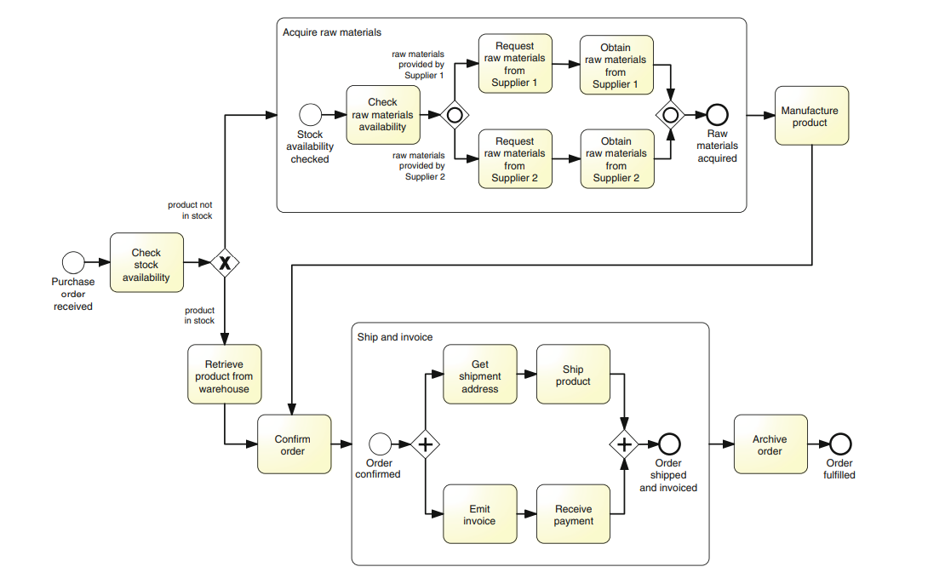
Process before Decomposition

Slide 21
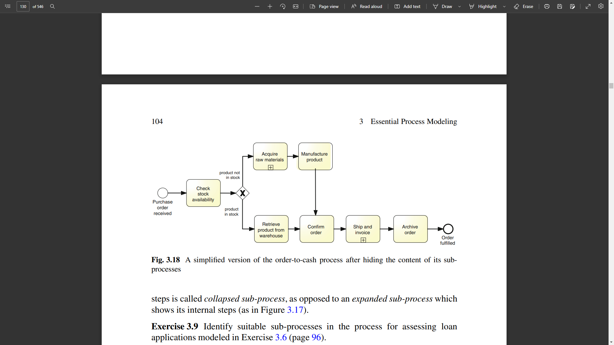
Process after Decomposition

Slide 22
Process Model Reuse
Process model reuse is reutilization of sub processes within a process.
Usually sub processes are embedded within its parent process model and can be invoked within the parent process.
These sub process can be used in a different process by declaring the sub process as global.
These global sub processes are not embedded to within any process model. So can be invoked in different process.

Slide 23
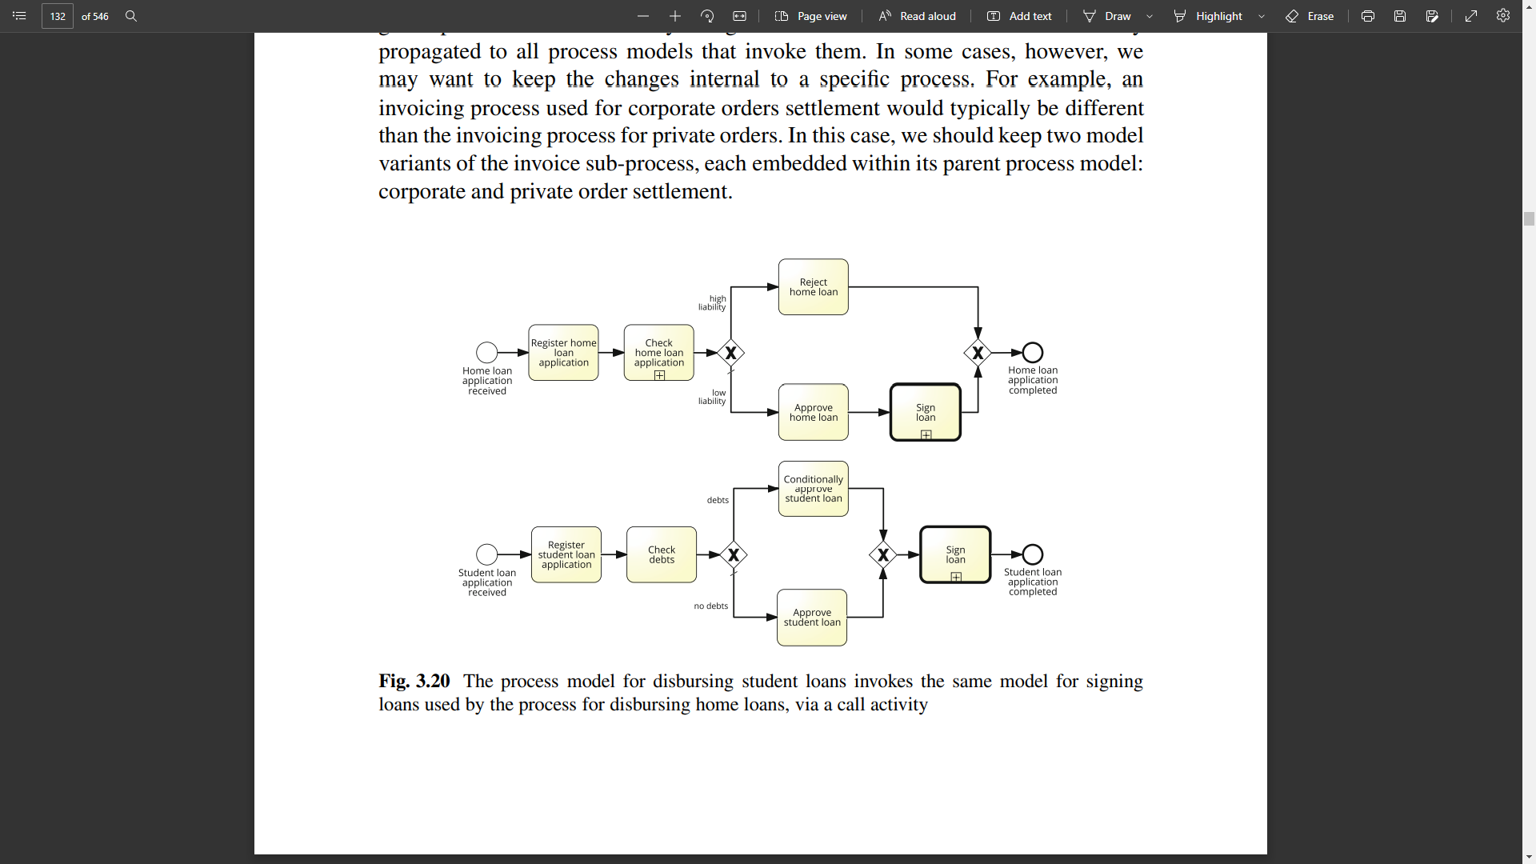
Process Model Reuse Example:

Slide 24
THANK YOU

